Slide 1
Customer Retention – A case Study
Khushboo Khatri

Slide 2
AGENDA
Introduction​
Review of Literature
​Statistical Analysis
Exploratory Data Analysis
​Conclusion

Slide 3
Introduction
E-retail factors for customer activation and retention: A case study from Indian e-commerce customers:
Customer satisfaction has emerged as one of the most important factors that guarantee the success of online store; it has been posited as a key stimulant of purchase, repurchase intentions and customer loyalty.
A comprehensive review of the literature, theories and models have been carried out to propose the models for customer activation and customer retention.
Five major factors that contributed to the success of an e-commerce store have been identified as: service quality, system quality, information quality, trust and net benefit.
The combination of both utilitarian value and hedonistic values are needed to affect the repeat purchase intention (loyalty) positively.

Slide 4
PRIMARY GOALS
Customer Retention: Repeat purchase from existing customer, is very important for the business to make profit. We will need to perform both statistical analysis and Exploratory Data Analysis for the dataset provided.

Slide 5
Review of Literature
What is Customer Retention?
Customer retention is a metric that measures customer loyalty, or the ability for an organization to keep its customers over time.
Benefits Of Customer Retention:
Reducing the cost of customer acquisition. Acquiring new customers is costly, time-consuming, and energy intensive.
Increasing the value of each sale.
Gaining insight into your customers.
Building referrals and loyalty.
Reducing customer churn.

Slide 6
How to improve Customer Retention?
Some of the commonly used strategy used by companies are:
Good Values Build Good Relationships.
Trust Is the Basis for Good Relationships.
Build Customer Expectations and Over Deliver Every Time.
Let Customer Data Work for You.
There's Always Room for Improvement.
Keep Customers in the Loop.
Determine Customer Lifetime Value.
Reward Loyalty.
We tried to make a model to explain this concept clearly, and contemplate all the factors responsible for customer retention in one frame.

Slide 7
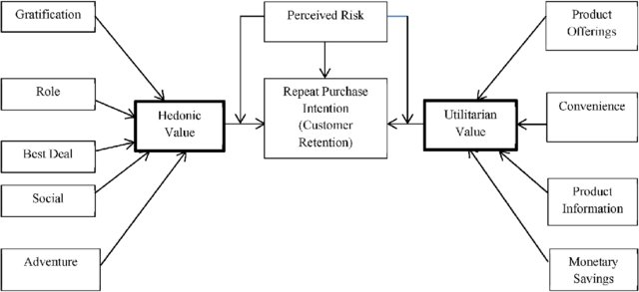
Important Factors
In our case study, we came to know that both Hedonic values and Utilitarian values both has impact on customers to decide to do repeat purchase.

Slide 8
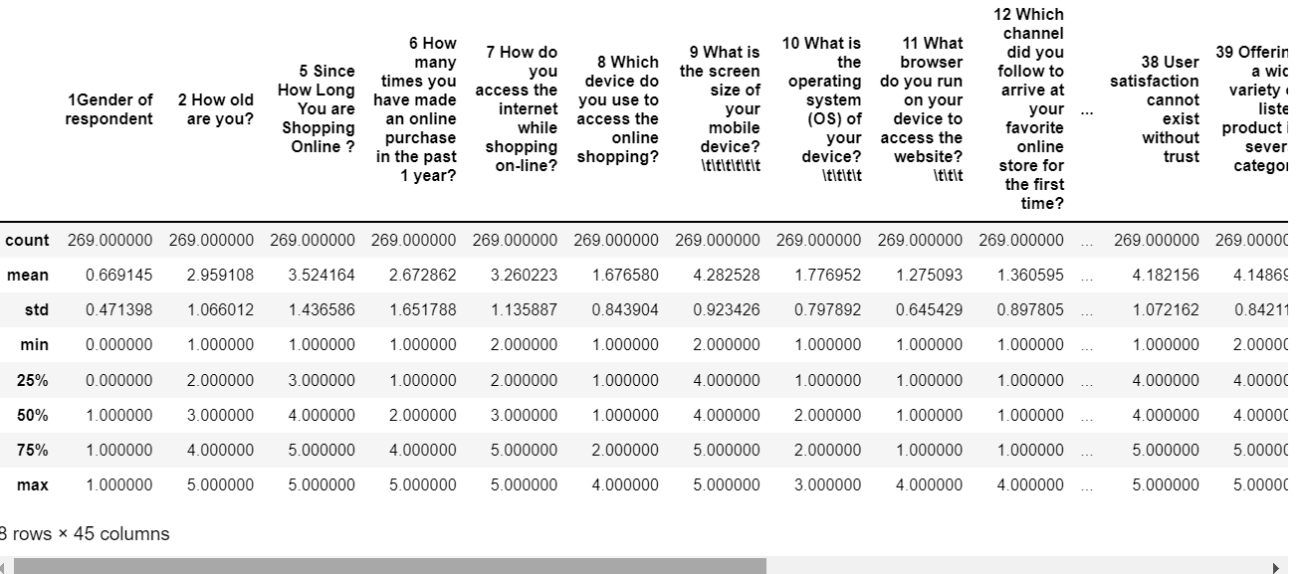

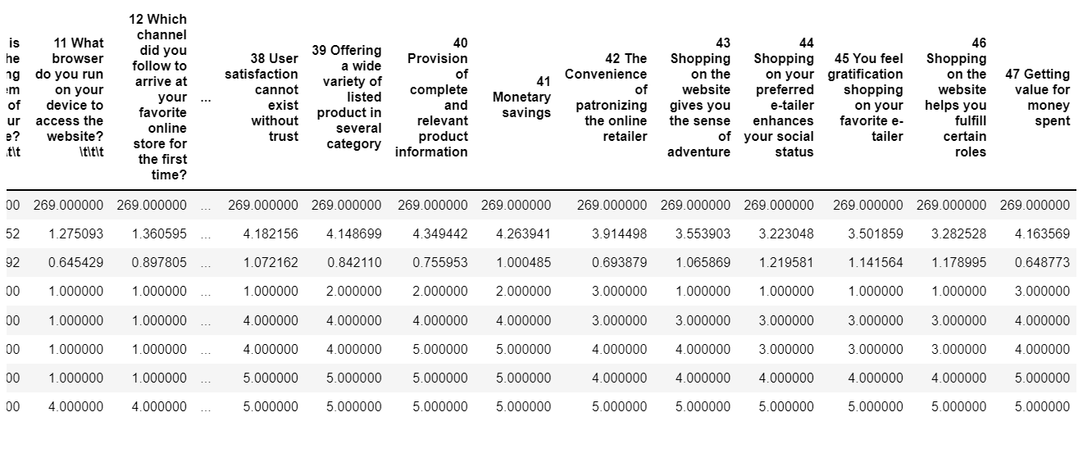
Statistical Analysis
Observations
We can observe that the mean value for from column 18-42, 47 are around 4 which means most of the customers agrees with the statement given.
From column 43-46 we can responses mean as 3-3.5 meaning customers do have indifferent opinion about online shopping as in getting sense of adventure, enhance social status, fulfil certain roles, basically some of the hedonic values.
While they feel strongly in favour about their utilitarian values.

Slide 9
Exploratory Data Analysis
Informational Analysis
Rating analysis
Top Picks
From columns 1-17 are merely the information gathered from customers, like there gender, age range, city, pincode, purchase habit, list goes on.
From column 18-47 is their response towards the information provided by online shopping website or application.
48-71 column which we are seeing here is merely kind of survey taken to see where leading online shopping companies stand on various parameters, and gives us details about what website or application customers preferred over others and why.

Slide 10
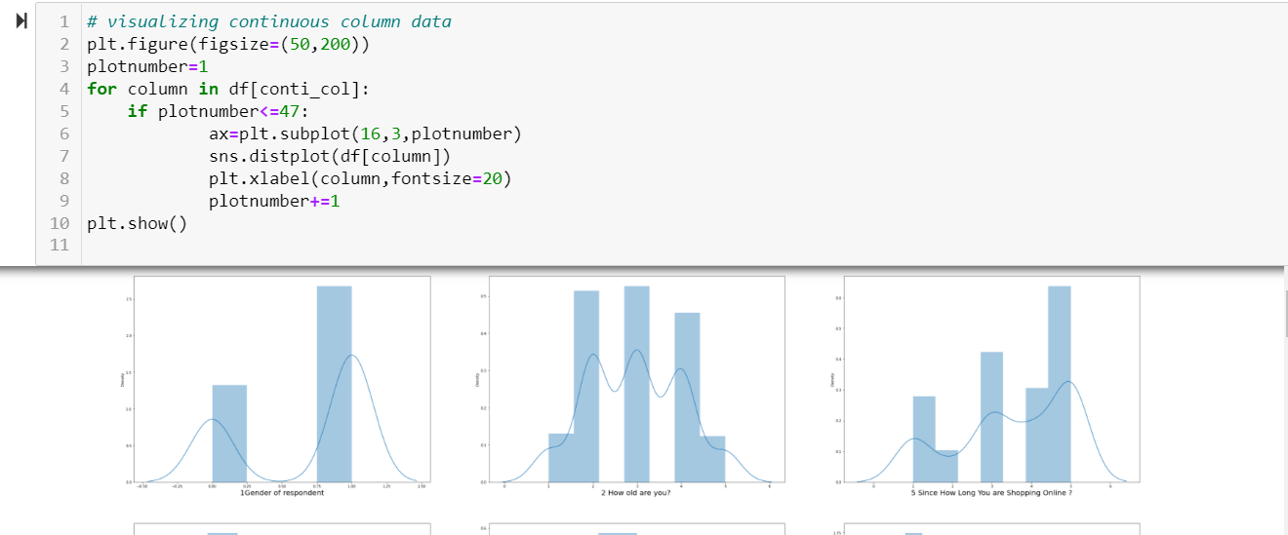
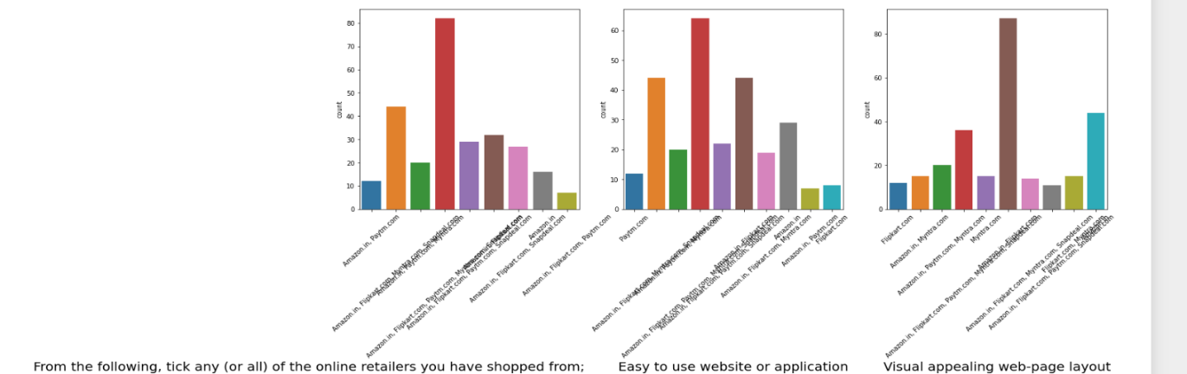
Let’s see how all data is distributed, Univariate Analysis
Most of our data from column 1-17 are discrete in nature, and distribution shows it clearly.
From column 18-24 is rating data, its distribution is more like bell shape .
We draw count plot to see multiple choice data, it gives us clear picture about customers choice .
In multiple choice we put 5 leading online stores and see how they perform on various aspects.

Slide 11
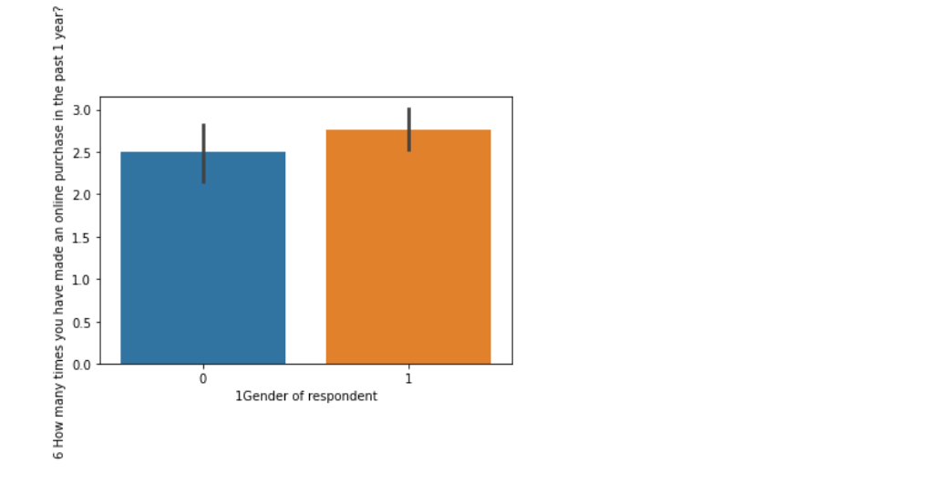
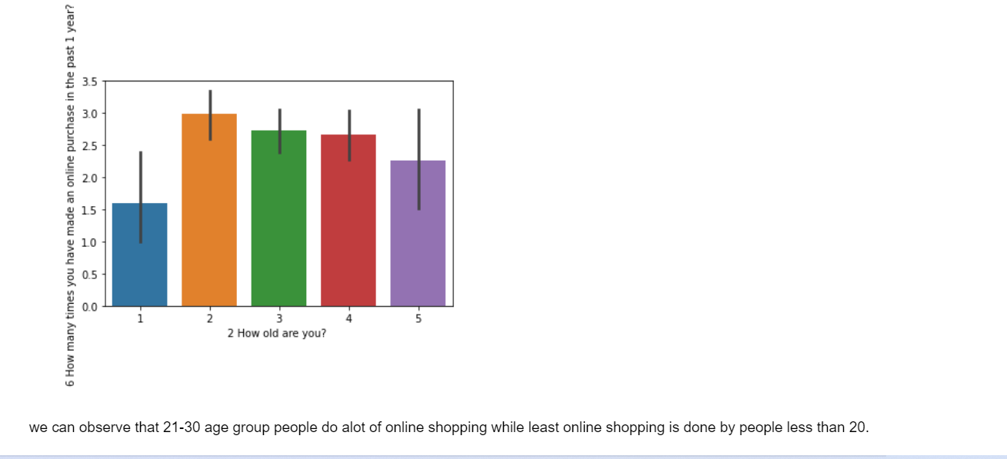
MultiVAriate analysis
Observations:
From here we can observe that Female did more online shopping than male over past one year.
When talking about Age, every range is almost same with minor difference , however, the highest shopping is done by customer age between 21-30 and least shopping is dome by customer below 20 years

Slide 12
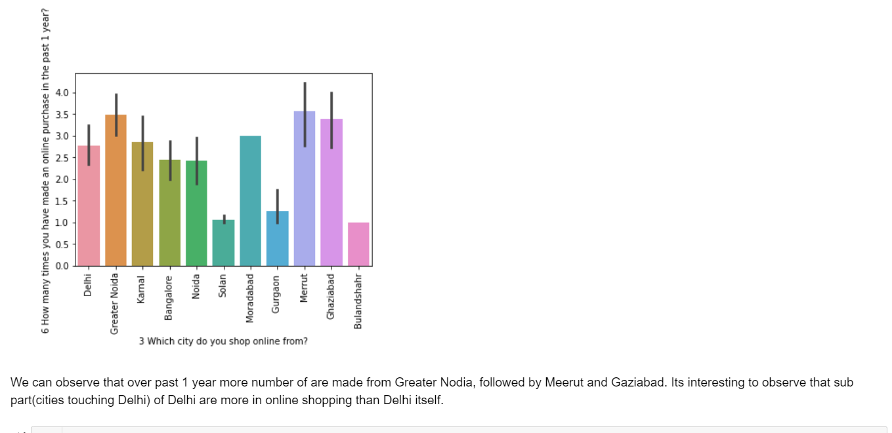
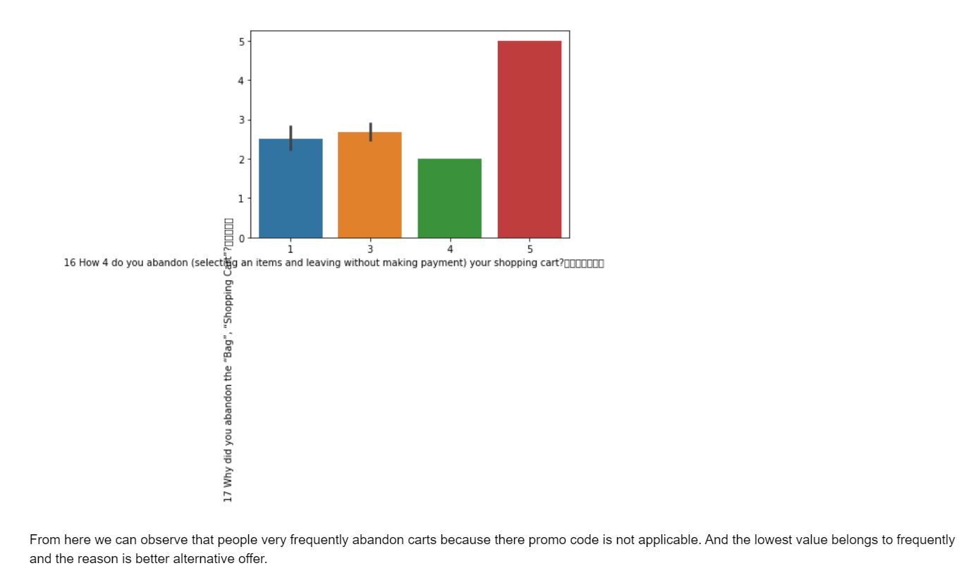
Here we can observe that customer abandon their cart/bag frequently because there promo code is not applicable.
Graph 2 represents from which city maximum online shopping is done from. It’s interesting to observe that sub urban cities of Delhi like Meerut, Gaziabad, Greater Noida shows more online shopping than Delhi itself.

Slide 13
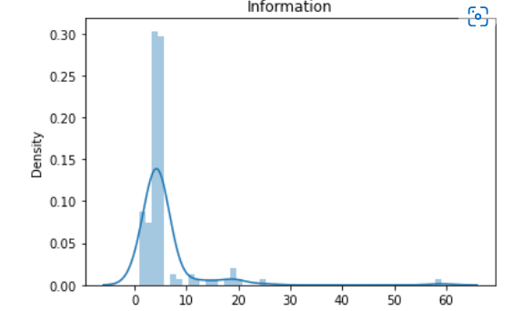
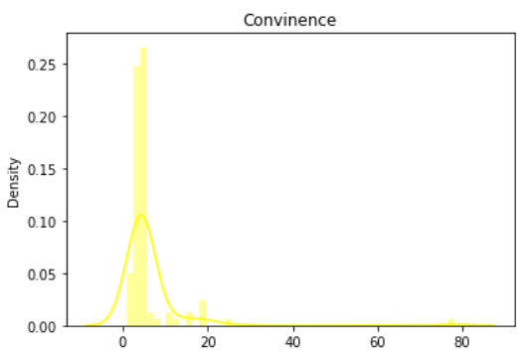
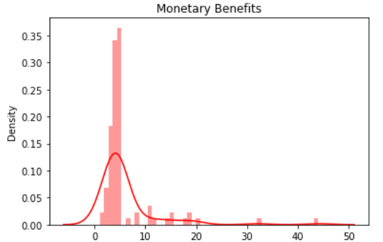
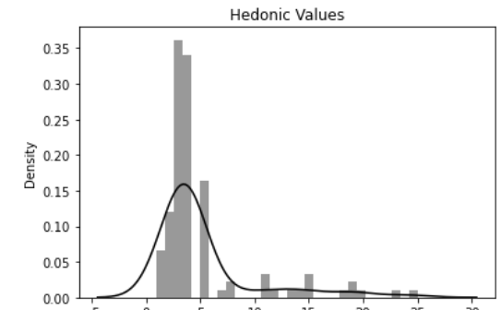
We make some groups within the dataset naming Information, Convenience, Monetary Benefits, and Hedonic values and came to observe typical bell shape curves, which means our data is properly distributed.
We can observe the high’s and lows of the information provided and can say that these are basis of our analysis for customer retention.

Slide 14
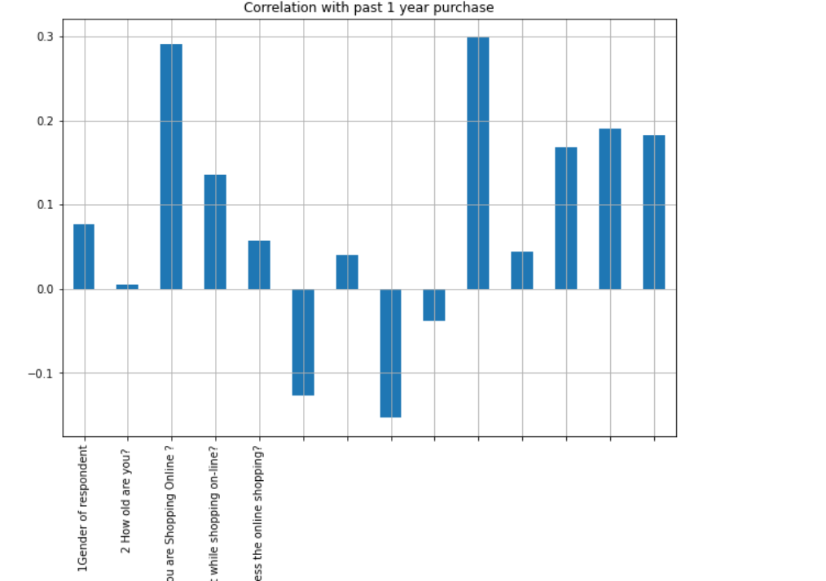
The best way to understand the relation between features and label is correlation analysis. Before moving with correlation matrix, let’s have a look how our features are correlated with our label, we are considering “Purchase in past one year” as our label, as this gives us proper idea repeat purchase.
From here we observe that 'After first visit, how do you reach the online retail store?' is highly correlated to repeat purchase, and second feature which also shows very strong correlation is 'Since How long you are shopping online?' while the least correlated feature is 'How old are you?'.

Slide 15
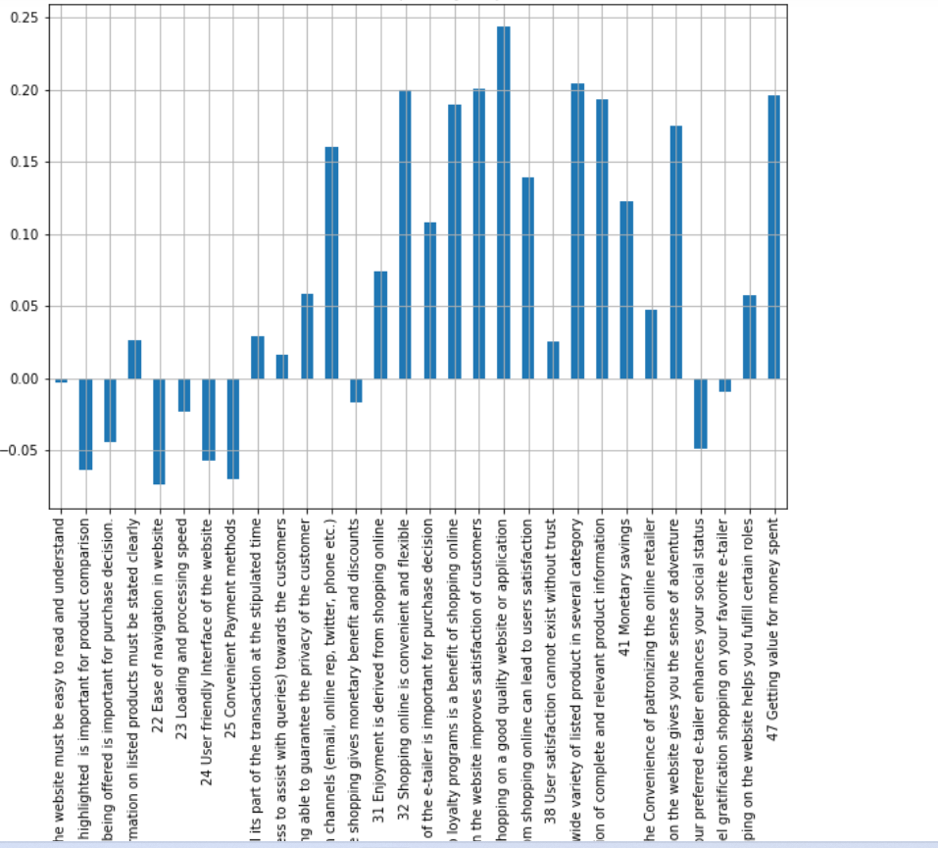
We also try to correlated our rating columns with past year purchase here.
From here we can say that customer retention is highly correlated with quality information which leads to customer satisfaction. Also, we notice that, website must be easy to read and understand is least correlated with past 1 year purchase

Slide 16
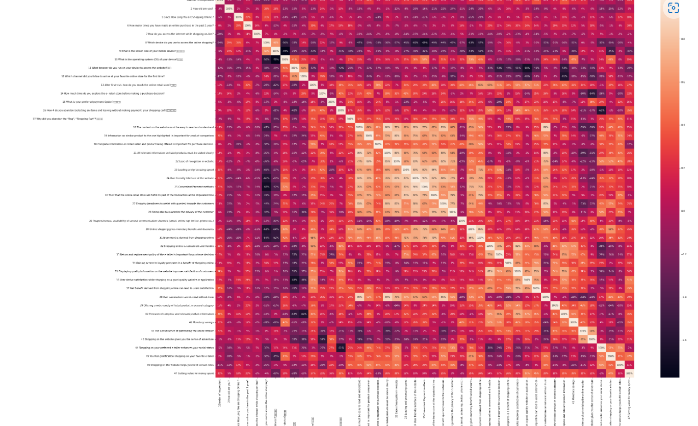
Correlation Matrix

Slide 17
Conclusion
Customer retention is highly correlated with customer satisfaction, a happy customer will retain with the app or website for future purchases. For that we can divide the factors into major two categories Utilitarian and Hedonic values.
Under Utilitarian values we include product information, product offerings, monetary benefits, and convenience. These are the major factors which can affect customer decision to make purchase, while Hedonic values basically related to outer self, idealism related to sense of adventure, role fulfilment, social status, gratification and list goes on. These are basically things we did for sake of others.
We also see that females are move likely to do online shopping than male, also young people in age range of 21-30 are likely to do more online shopping than others.
In short, we can say that out data definitely provide us some insight about the customer retention on online platforms, and in second part of data we also observe that out of all websites mentioned, Amazon.in followed by Flipkart full fill most of the tick marks with flying colours. customer trust on these platforms with their information, security of data and overall customer service/convenience offered by them.

Slide 18
THANK YOU

